Slide 1
AGILE vs waterfall
CS250
Software Development Lifecycle
Anthony Hackman

Slide 2
Agenda
Agile Roles in Scrum
Agile Phases
Waterfall Model Overview
Waterfall vs Agile
Conclusion

Slide 3
Agile Roles in Scrum
Product Owner
Provide direction to the team on what will be built.
Prioritize the work to be done
Maximize the value of the product and the work of the development team
Tester
Define acceptance criteria and tests
Clarify ambiguity found in the code and user stories
Execute tests and analyze results
Collaborate with the team to resolve issues and defects
Scrum Master
Ensuring effective backlog management
Helping development team to create high-value products
Removing challenges slowing the development progress
Facilitating Scrum events
Developer
Designing and developing code according to solid software engineering practices
Participating in peer reviews
Collaborate with the team to produce enough design to have room for iteration

Slide 4
Agile Phases
I. Concept / Inception
Define project vision and key objectives
Identify stakeholders and key requirements
Create an initial backlog, form Agile teams
II. Iteration / Increment
Work in short sprints (2-4 weeks)
Develop, integrate, and continuously test features
Hold daily stand-up meetings for collaboration
III. Release
Deliver functional increments after each sprint
Conduct sprint review and retrospective
Gather user feedback and refine the product
IV. Maintenance
Fix bugs, optimize performance, and support users
Plan future enhancements and continuous improvements
Ensure long-term stability and scalability

Slide 5
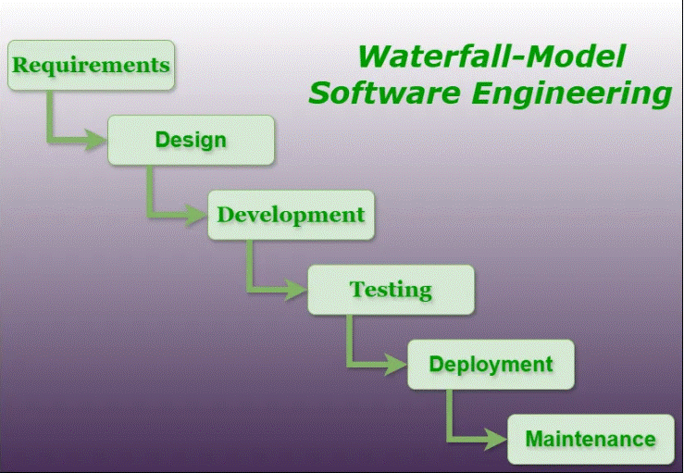
Waterfall ​
Requirements Gathering
Define and document all system and business requirements upfront.
System Design
Create detailed architecture and design based on the requirements.
Development (Implementation)
Developers write and integrate the code.
Testing
Perform system, integration, and user acceptance testing.
Deployment
Release the fully developed product to users.
Maintenance
Address bugs, updates, and necessary improvements post-launch.
https://www.geeksforgeeks.org/waterfall-model/

Slide 6
Waterfall vs Agile
1 | Best if requirements are clear and fixed. | Ideal for projects with changing or evolving requirements.
2 | Works well for small, well-defined projects. | Suited for complex, large-scale projects needing flexibility.
3 | Limited interaction after initial requirements gathering. | Continuous feedback and collaboration with stakeholders.
4 | Longer upfront planning but predictable delivery. | Faster iterations with incremental releases.
5 | High risk if changes occur late in development. | Lower risk due to continuous adjustments and early issue detection.
6 | Testing is done at the end, making bug fixes costly. | Testing is ongoing throughout development, reducing late-stage risks.
Project Requirement Stability
Project Size and Complexity
Customer Involvement​
Development Timeline
Risk Management
Testing Approach

Slide 7
Conclusion
Waterfall when requirements are stable, and a structured approach is needed.
Agile when flexibility, iterative development, and customer collaboration are priorities.

Slide 8
THANK YOU
Anthony Hackman
anthony.hackman@snhu.edu
Beck, K., et al. (2001) The Agile Manifesto. Agile Alliance. http://agilemanifesto.org/
Cobb, C. G. (2015). The Project Manager’s Guide to Mastering Agile: Principles and practices for an adaptive approach. John Wiley & Sons.
Martin, R. C. (2020). Clean agile: Back to basics. Pearson.
Atlassian. (n.d.). Agile vs. Waterfall Project Management. https://www.atlassian.com/agile/project-management/project-management-intro

